Slide 1
Naïve Bayesian
How to classify reading passages into predefined categories
ASH

Slide 2
Text Classification
Assigning subject categories, topics, or genres
Spam detection
Authorship identification
Age/gender identification
Language Identification
Sentiment analysis
And so on..
Notes:
----- Meeting Notes (8/22/14 09:52) -----
첫 페이지
정의/결론

Slide 3
Process
Document
Pre-processing
Feature/indexing
Performance measure
Applying classification algorithm
Feature filtering

Slide 4
Pre-processing
Documents
Removal of Stop words
Stemming words
Pre-processed data

Slide 5
Classification Methods (1)
Manual classification
Used by the original Yahoo! Directory
Accurate when job is done by experts
Consistent when the problem size and team is small
Difficult and expensive to scale
Means we need automatic classification methods for big problems

Slide 6
Classification Methods (2)
Hand-coded rule-based classifiers
Commercial systems have complex query languages
Accuracy is can be high if a rule has been carefully refined over time by a subject expert
Building and maintaining these rules is expensive

Slide 7
Classification Methods (3): Supervised learning
Given:
A document d
A fixed set of classes:
C = {c₁, c₂,…, c_{J}}
A training set D of documents each with a label in C
Determine:
A learning method or algorithm which will enable us to learn a classifier γ
For a test document d, we assign it the class
γ(d) ∈ C

Slide 8
Classification Methods (3)
Supervised learning
Naive Bayes (simple, common)
k-Nearest Neighbors (simple, powerful)
Support-vector machines (new, generally more powerful)
… plus many other methods
No free lunch: requires hand-classified training data
But data can be built up (and refined) by amateurs
Many commercial systems use a mixture of methods

Slide 9
What is the Naïve Bayes Classifier?
A simple probabilistic classifier which is based on Bayes theorem with strong and naïve independence assumptions.
Assumption→ features used in the classification are independent
Despite the naïve design and oversimplified assumptions that this technique uses, Naïve Bayes performs well in many complex real-world problems.

Slide 10
When to use the Naïve Bayes Text Classifier?
It is less computationally intensive and requires a small amount of training time.
When you have limited resources in terms of CPU and Memory.
Moreover, when the training time is a crucial factor.
Keep in mind that the Naïve Bayes classifier is used as a baseline in many researches.

Slide 11
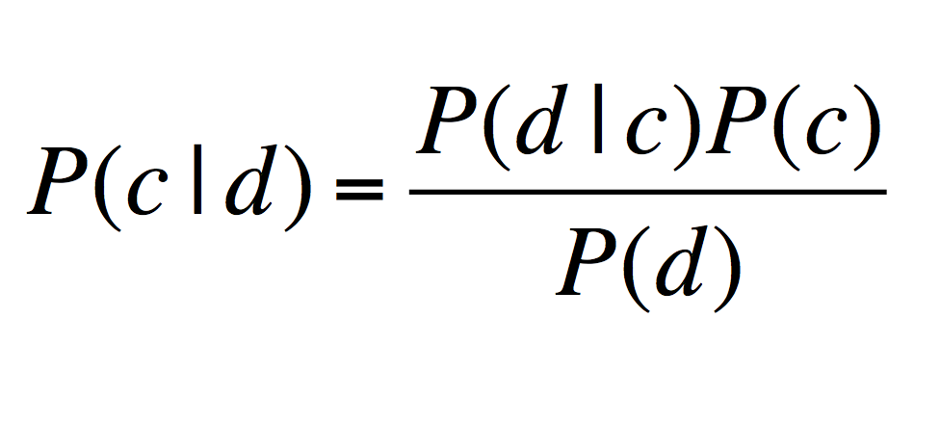
Bayes’ Rule Applied to Documents and Classes
For a document d and a class c
Notes:
----- Meeting Notes (8/22/14 09:53) -----
equation/table stand for

Slide 12
Naive Bayes Classifiers
Task: Classify a new instance D based on a tuple of attribute values into one of the classes c_{j} ∈ C
MAP = Maximum Aposteriori Probability

Slide 13
Underflow Prevention: log space
Multiplying lots of probabilities, which are between 0 and 1, can result in floating-point underflow.
It will be rounded to zero, and our analyses will be useless.
Class with highest final un-normalized log probability score is still the most probable.
Note that model is just max of sum of weight
Notes:
Since log(xy) = log(x) + log(y), it is better to perform all computations by summing logs of probabilities rather than multiplying probabilities.
Addressing practical computational problems : 10^-3 * 10^-4 = 0.0000001 VS log (10^-3 * 10^-4) = -7

Slide 14
The Naïve Bayes Classifier
1) Conditional Independence Assumption: Features (term presence) are independent of each other given the class:
2) Position Independence Assumption:
Word appearance does not depend on position
For all positions i, j, word w, and class c

Slide 15
Learning the Model
maximum likelihood estimates
simply use the frequencies in the data

Slide 16
Problem with Max Likelihood
What if a particular feature/word does not appear in a particular class?
To avoid this, we will use Laplace smoothing by adding 1 to each count:
# of terms contained in the vocabulary j

Slide 17
Naïve Bayes: Learning Algorithm
From training corpus, extract Vocabulary
Calculate required P(c_{j}) and P(x_{k} | c_{j}) terms
For each c_{j} in C do
docs_{j} ← subset of documents for which the target class is c_{j}
Text_{j} ← single document containing all docs_{j}
for each word x_{k} in Vocabulary
n_{k} ← number of occurrences of x_{k} in Text_{j}

Slide 18
Naïve Bayes: Classifying
Return c_{NB}, where
Positions ← all word positions in current document which contain tokens found in Vocabulary

Slide 19
Two Models
Model 1: Multivariate Bernoulli
Used when in our problem the absence of a particular word matters.
Ex) Spam or Adult Content Detection
Hold 1st assumption of Naïve bayesian
fraction of documents of topic c_{j}
in which word w appears

Slide 20
Two Models
Model 2: Multinomial = Class conditional unigram
Used when the multiple occurrences of the words matter a lot in the classification problem.
Ex) Topic classification
Hold 1st and 2nd assumption of Naïve Bayesian
Use same parameters for each position
Result is bag of words model (over tokens not types)
fraction of times in which
word w appears
across all documents of topic c_{j}

Slide 21
The bag of words representation
γ(
I love this movie! It's sweet, but with satirical humor. The dialogue is great and the adventure scenes are fun… It manages to be whimsical and romantic while laughing at the conventions of the fairy tale genre. I would recommend it to just about anyone. I've seen it several times, and I'm always happy to see it again whenever I have a friend who hasn't seen it yet.
)=c
Naïve Bayes relies on Bag of words representation

Slide 22
The bag of words representation: using a subset of words

Slide 23
The bag of words representation
great | 2
love | 2
recommend | 1
laugh | 1
happy | 1
... | ...
γ(
)=c

Slide 24
Bag of words for document classification

Slide 25
Feature Selection: Why?
Text collections have a large number of features
10,000 – 1,000,000 unique words … and more
Feature Selection
Makes using a particular classifier feasible
Some classifiers can’t deal with 100,000 of features
Reduces training time
Training time for some methods is quadratic or worse in the number of features
Can improve generalization (performance)
Eliminates noise features

Slide 26
Feature selection: how?
Two ideas:
Chi-square test (χ²)
Test whether the occurrence of a specific term and the occurrence of a specific class are independent.
Clear information-theoretic interpretation
May select rare uninformative terms
Mutual information (MI)
How much information does the value of one categorical variable give you about the value of another
Statistical foundation
May select very slightly informative frequent terms that are not very useful for classification
They’re similar, but χ² measures confidence in association, (based on available statistics), while MI measures extent of association (assuming perfect knowledge of probabilities)

Slide 27
Feature Selection: Frequency
The simplest feature selection method:
Just use the commonest terms
No particular foundation
But it make sense why this works
They’re the words that can be well-estimated and are most often available as evidence
In practice, this is often 90% as good as better methods

Slide 28
Example

Slide 29
Example
The denominators are (8 + 6) and (3 + 6) because the lengths of text_{c} and are 8 and 3, respectively, and because the constant B is 6 as the vocabulary consists of six terms.

Slide 30
Example
Thus, the classifier assigns the test document to c = China. The reason for this classification decision is that the three occurrences of the positive indicator CHINESE in d₅ outweigh the occurrences of the two negative indicators JAPAN and TOKYO.

Slide 31
Evaluating Categorization
Evaluation must be done on test data that are independent of the training data
Sometimes use cross-validation (averaging results over multiple training and test splits of the overall data)
Measures: precision, recall, F1, classification accuracy
Classification accuracy: r/n where n is the total number of test docs and r is the number of test docs correctly classified

Slide 32
Experiment
Training data: 13188 sets
Category: Science or Humanity (Binary) or
Science, Humanity, Social-science, Art, Business (5 categories)
Test data: Using 10-fold method (K-fold)

Slide 33
Two category
Classifiers | Accuracy | Precision | Recall | F-measure
NB | 92.49% | 92.9% | 92.5% | 92.5%
RBF network | 59.32% | 58.5% | 59.3% | 57.2%
Bagging | 92.34% | 92.5% | 92.3% | 92.4%
ZeroR | 56.25% | 31.6% | 56.3% | 40.5%
Random Forest | 90.47% | 91% | 90.5% | 90.5%
Lib SVM | 94.85% | 94.9% | 94.9% | 94.9%
Five category
Classifiers | Accuracy | Precision | Recall | F-measure
NB | 76.91% | 78.5% | 76.9% | 76.9%
RBF network | 50.08% | 25.1% | 50.1% | 33.4%
Bagging | 81.93% | 81.6% | 81.9% | 81.6%
ZeroR | 50.08% | 25.1% | 50.1% | 33.4%
Random Forest | 76.67% | 76.2% | 76.7% | 75.8%
Lib SVM | 88.61% | 88.6% | 88.6% | 88.5%

Slide 34
Naive Bayes is Not So Naive
Very fast learning and testing (highly efficient)
Low storage requirements
Robust to irrelevant(noise) features and concept drift

Slide 35
References
http://web.stanford.edu/class/cs124/lec/naivebayes.pdf
http://research.ijcaonline.org/volume68/number17/pxc3887301.pdf
http://blog.datumbox.com/machine-learning-tutorial-the-naive-bayes-text-classifier/

