Slide 1
Learning Deep Architectures for AI
Yoshua Bengio

Slide 2
Deep Architecture in our Mind
○ Humans organize their ideas and concepts hierarchically
○ Humans first learn simpler concepts and then compose them to represent more abstract ones
○ Engineers break-up solutions into multiple levels of abstraction and processing

Slide 3
Why go deep?
Deep Architectures can be representationally efficient
– Fewer computational units for same function
Deep Representations might allow for a hierarchy or Representation
– Allows non-local generalization
– Comprehensibility
• Multiple levels of latent variables allow combinatorial sharing of statistical strength
• Deep architectures work well (vision, audio, NLP, etc.)!

Slide 5
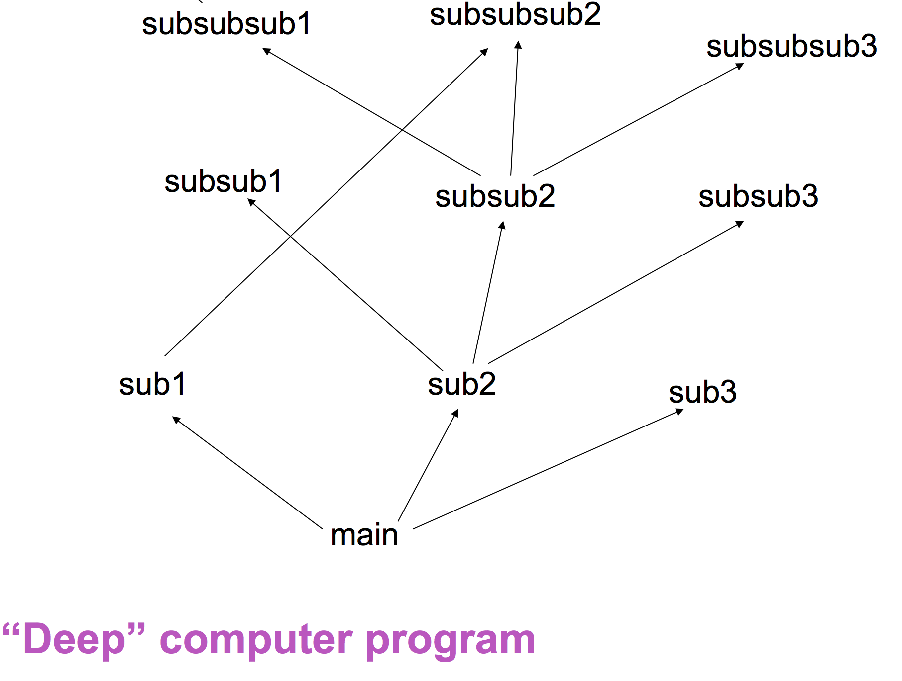

Slide 6
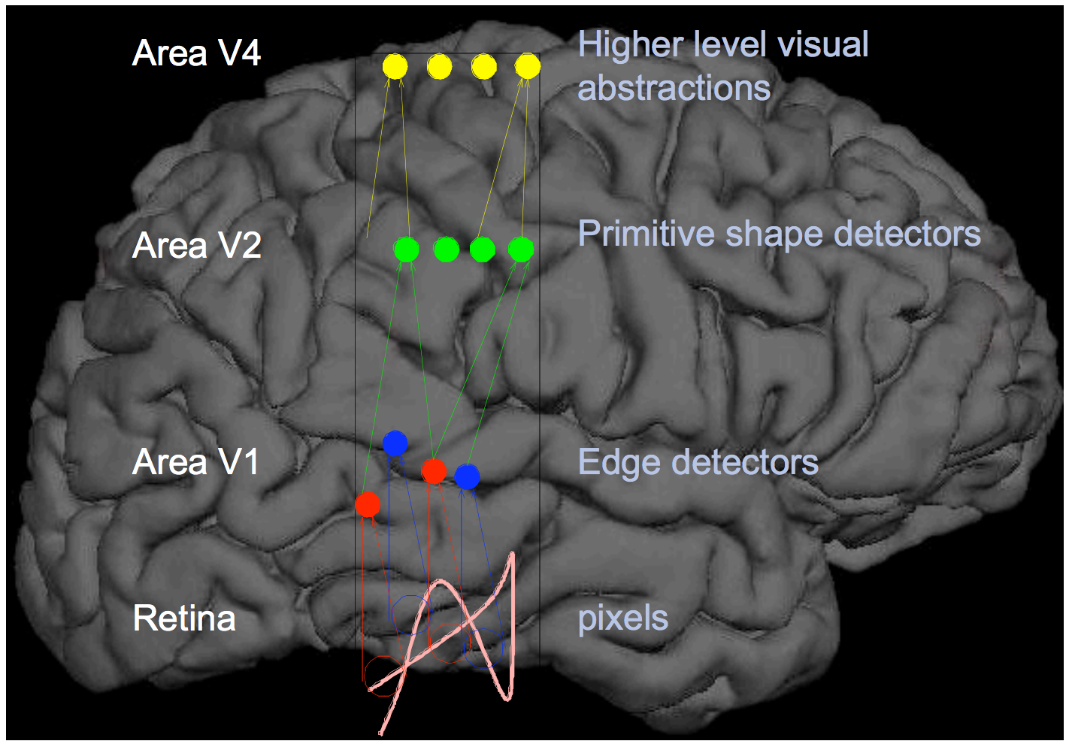
Deep architecture in brain
Notes:
Brain has a deep architecture.
Cortex seems to have a generic learning algorithm.
Humans ﬁrst learn simpler concepts and then compose them into more complex ones

Slide 7
Different Levels of Abstraction

Slide 8
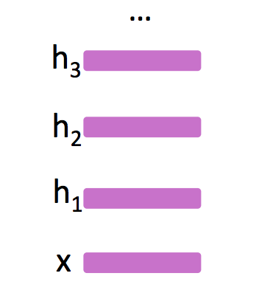
Deep learning
Automatically learning features at multiple levels of abstraction allow a system to learn complex functions mapping the input to the output directly from data, without depending completely on human-crafted features.
Depth of architecture: the number of levels of composition of non-linear operations in the function learned.

Slide 9
The Deep Breakthrough
Before 2006, training deep architectures was unsuccessful
○ Hinton, Osindero & Teh « A Fast Learning Algorithm for Deep Belief Nets », Neural Computation, 2006
○ Bengio, Lamblin, Popovici, Larochelle « Greedy Layer-Wise Training of Deep Networks », NIPS’2006
○ Ranzato, Poultney, Chopra, LeCun « Efficient Learning of Sparse Representations with an Energy-Based Model », NIPS’2006
Notes:
Despite prior investigation and understanding of many of the algorithmic techniques
Before 2006 training deep architectures was unsuccessful

Slide 10
Desiderata for Learning AI
1. Ability to learn complex, highly-varying functions
2. Ability to learn with little human input the low-level, intermediate, and high-level abstractions.
3. Ability to learn from a very large set of examples.
4. Ability to learn from mostly unlabeled data.
5. Ability to exploit the synergies present across a large number of tasks.
6. Strong unsupervised learning.

Slide 11
Architecture Depth

Slide 12
The need for distributed representations
Parameters for each distinguishable region.
# of distinguishable regions is linear in # of parameters.

Slide 13
Each parameter influences many regions, not just local neighbors.
# of distinguishable regions grows almost exponentially with # of parameters.

Slide 14
Unsupervised feature learning

Slide 15
Neural network
Neural network: running several logistic regressions at the same time.

Slide 16
Notes:
Simple to construct.
Use unsupervised learning

